Slide 1
AVIAN INFLUENZA- A CURRENT PERSPECTIVE
PRESTAGE DEPT. OF POULTRY SCIENCE
Simon M. Shane BVSc. FRCVS. Ph.D. MBL. ACPV
February 10th 2015

Slide 2
ECONOMIC IMPACT OF HPAI
COSTS INCURRED FROM:
BORDER CONTROL AND PERMITTING TO EXCLUDE AI.
PREPAREDNESS, TRAINING, INFRASTRUCTURE, R & D.
OUTBREAK CONTROL AND ERADICATION
GOVERNMENT SECTOR
PRIVATE SECTOR
CONSUMERS
DISRUPTION IN TRADE OF BREEDING STOCK, CHICKS AND PRODUCTS

Slide 3
FINANCIAL IMPACT OF HPAI
1924 U.S. $ 10 m (2000 VALUE)
1983 PA. $ 110m (USDA-APHIS)
$ 25m ( PRODUCERS)
$ 350m (CONSUMERS)
1999 ITALY $ 600m
1985 Australia $ 2m (SINGLE COMPLEX)

Slide 4
HISTORY OF HPAI
1878 and 1894 Italy and other European countries (where recognized)
1901 Germany and neighboring nations, Chickens “Fowl plague”
1924 and 1929 U.S., Chickens (H7)
1959 Scotland, Chickens H5N1
1961 South Africa, Terns H5N3
1976 Australia Chickens H7N7
1983 U.S. (PA, MD) Chickens , Turkeys H5N2
1995 Pakistan, Chickens H7N3
1997 Hong Kong, Chickens etc. H5N1
1999 Italy, Chickens etc H7N1
2001 China and other Asian nations, Chickens etc H5N1
2003 Mexico, Chickens etc. H5N2

Slide 5
RECENT HPAI OUTBREAKS
2003 Holland, Chickens H7N7
2012 Mexico, Chickens etc. H7N3
2013 Australia, Chickens H7N2
2014 Canada, (BC) Chickens etc. H5N2
2014 Russia, Chickens etc. H5N1
2014 India, Ducks and Chickens H5N8
2014 Korea, Japan, Ducks and chickens H5N8
2014 EU, Chickens, Turkeys and Ducks H5N8
2014 Taiwan, Ducks, Geese, Chickens H5N2 and H5N8 plus H5N3
2014 Canada, Chickens and Turkeys H5N2
2014/5 U.S. (OR, UT, WA, ID), wild birds, backyard flocks H5N2 &
H5N8, H5N1
2015 Nigeria, Chickens H5N?
2015 Israel, Palestine, Bulgaria, Turkeys and Chickens, H5N1

Slide 6
HUMAN HEALTH SIGNIFICANCE
MAMMALS GENERALLY REFRACTORY TO AVIAN STRAINS
Asia H5N1 from 2003 onwards
Holland H7N7 in 2003
China H7N9 2013 onwards
Egypt H5N1 mid 2000’s onwards
Mild cases (conjunctivitis )
Severe cases (respiratory complications and death)
Marked decline in egg and chicken consumption

Slide 7
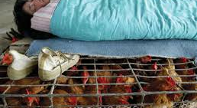
CLOSE CONTACT WITH INFECTED FLOCKS RESULTSED IN H5N1 INFECTION IN GENETICALLY PREDISPOSED HUMANS

Slide 8
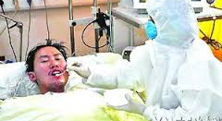
MOST OF THE 500 CASES OF HUMAN H5N9 AI INFECTION HAVE BEEN DOCUMENTED IN CHINA WITH HIGH FATALITY RATES

Slide 9
AVIAN INFLUENZA VIRUS
Family: Orthomyxoviridae
Genus: Influenzavirus A
RNA virus with enveloped virion, 80-120 nm
Eight single RNA strands coding for:-
1. PB 1 transcriptase
2. PB 2 endonuclease
3. PA RNA replication
4. HA attachment, envelope fusion, neutralization
5. NP vRNA synthesis
6. NA virus elution,
7. M 1 & 2 virus budding
8. NS 1 & NS 2 translation of viral mRNA

Slide 10
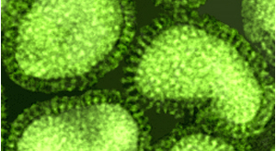
EM VIEW OF AI ORTHOMYXOVIRUS SHOWING SURFACE HA AND NA GLYCOPROTEIN ANTIGENS

Slide 11
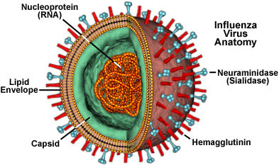
STRUCTURE OF INFLUENZA VIRUS

Slide 12
AVIAN INFLUENZA NOMENCLATURE
A / chicken/ Indonesia/ 4 / H7N8/09
A/ chicken /Pennsylvania/ 1370/83
15 HA (hemagglutinin) serotypes
9 NA (neuraminidase) serotypes
“Highly pathogenic avian influenza” H5 and H7
“Low pathogenic avian influenza” 13 other HAs

Slide 13
ANTIGENIC VARIATION
Surface HA and NA glycoproteins undergo frequent changes.
Antigenic Drift
Arises by point mutation. (vaccination pressure and
population density?)
H5 and H7 strains of LPAI becoming HPAI
Antigenic Shift
Arises from genetic reassortment

Slide 14
SIGNIFICANCE OF VIRAL SHIFT REASSORTMENTS
A/goose/Taiwan/??/2015 H5N3
Identified mid-January 2015
H5 99% similar to 2014 H5N8 isolate involved in extensive outbreaks in S.Korea and Japan.
N3 98% similar to 2010 H2N3 Taiwan isolate migratory ducks
2011 H1N3 Thailand isolate in waterfowl
2013 H5N3 Taiwan isolate migratory ducks

Slide 15
OIE CRITERIA FOR HPAI
1. AI isolate lethal to +6/8 5-week SPF chickens receiving 0.2 ml 10⁻¹ allantoic fluid iv.
2. Any H5 or H7 isolate with a preponderance of basic amino acids at the HA cleavage site.
3. Any isolate other than an H5 or H7 lethal to 1 to 5 chickens and can be grown in cell culture without trypsin

Slide 16
SENSITIVITY OF AI VIRUS
Inactivated by:-
solvents and detergents
aldehydes (formalin and gluteraldehyde)*
oxidizing agents (sodium hypochlorite 5%)*
chemical disinfectants (phenolics, QACs)*
* ONLY if not protected by organic matter.
AI virus can persist in liquid manure for 100 days in NE U.S winter
in feces for 30 days at 4° F
Susceptible to 90° F in “cleaned” houses for 1 week

Slide 18
ORIGIN OF AI VIRUS STRAINS
Role of Asia in evolution of AI strains
Migratory waterfowl to domestic waterfowl
Spread to chickens and mixing in hogs and other mammalian hosts in rural locations. Reassortment events (“shifts”) occur to produce pandemic strains infecting humans. Can be induced under laboratory conditions.
Endemic infection can lead to mutations (“drift”) when introduced into areas with high population density-LPAI to HPAI.

Slide 19
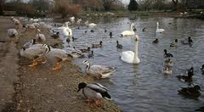
COHABITATION OF DOMESTIC AND MIGRATORY WATERFOWL RESULTS IN TRANSMISSION AND DISSEMINATION OF HPAI

Slide 20
DISSEMINATION OF AI
Intercontinental and international:
Migratory waterfowl and shore birds
Uncooked poultry products
Contaminated personnel
Regional and local
Movement of live poultry (LBM systems)
Movement of contaminated personnel and
equipment (fomites)
Virus entrained on dust particles in air.
Contaminated housing and waste

Slide 21
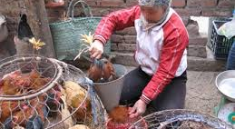
LIVE BIRD MARKETS IN ASIA ARE ARE A SOURCE OF AI VIRUS FOR CONSUMERS AND A RESERVOIR FOR POULTRY FLOCKS

Slide 22
CLINICAL PRESENTATION OF HPAI
SHARP DROP IN WATER AND THEN FEED INTAKE
CONCURRENT RAPID ASCENDING MORBIDITY
RATE (10%; 40 % 80% CUMULATIVE ON SUCCESSIVE DAYS)
LAYERS AND BREEDERS CEASE PRODUCTION (OVER 2 TO 3 DAYS , PRESENCE OF SHELL-LESS EGGS)
SIMULTANEOUS RAPID ASCENT IN MORTALITY RATE (5%; 25%; 50% CUMULATIVE OVER SUCCESSIVE DAYS)
TYPICAL SIGNS (PROSTRATION, RESPIRATORY DISTRESS,
DIARRHEA, SWOLLEN CYANOTIC HEADS, SKIN
HEMORRHAGES)

Slide 23
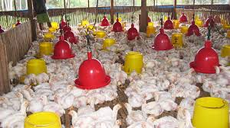
EXTENSIVE MORBIDITY IN FLOCK INFECTED WITH HPAI. RECUMBENCY, RESPIRATORY DISTRESS EVIDENT IN SMALL FLOCK

Slide 24
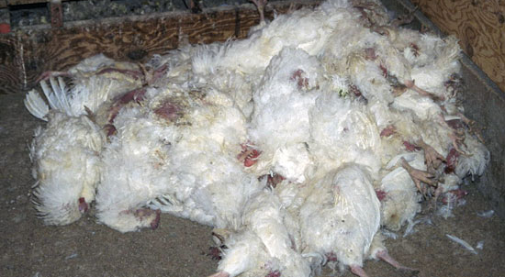
RAPIDLY ASCENDING MORTALITY FOLLOWING HPAI INFECTION LEADS TO A “CARPET OF DEAD BIRDS”

Slide 25
CUTANEOUS LESIONS HPAI

Slide 26
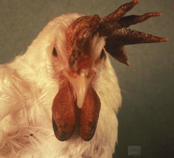
SWOLLEN WATTLES, NECROSIS OF COMB WITH HPAI

Slide 27
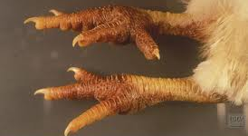
CHARACTERISTIC SUBCUTANEOUS HEMORRHAGES ON THE SHANKS OCCUR FOLLOWING HPAI INFECTION

Slide 28
LESIONS OF HPAI
EDEMATOUS , HEMORRHAGIC AND NECROTIC CHANGES IN ADNEXA (SKIN, WATTLES, COMB, SHANKS)
VISCERAL SEROSAL HEMORRHAGES
FIBRINOUS PERITONITIS (NON-PERACUTE CASES)
NOTE: GROSS LESIONS ARE NOT PATHOGNOMONIC. D/D INCLUDES vvND (END),
COMBINATIONS OF vvIBD/ILT/LENTOGENIC ND

Slide 29
DIAGNOSIS OF HPAI
VIRAL ISOLATION:
SPF CHICKEN EMBRYOS –ALLANTOIC ROUTE WITH HI
ANTIGEN-CAPTURE ASSAY (DIRECTIGEN®)
VIRAL RNA:
PCR ASSAY
SEROLOGY:
HEMAGGLUTINATION INHIBITION
AGAR-GEL WELL AGGLUTINATION
ELISA

Slide 30
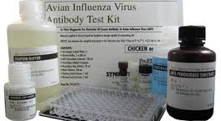
ELISA AI ANTIBODY TEST KITS AVAILABLE COMMERCIALLY

Slide 31
PREVENTION AND CONTROL OF HPAI
EXOTIC TO NATION
EXCLUSION BY RESTRICTING IMPORTS
RAPID DIAGNOSIS AND ERADICATION
(QUARANTINE, COMPENSATION, SURVEILLANCE, FLOCK DEPLETION AND DISPOSAL)
REGIONAL CONTROL OF MOVEMENT
(REGIONALIZATION AND COMPARTMENTALIZATION)
FARM BIOSECURITY
ENDEMIC TO NATION
REGIONALIZE AND RESTRICT INTERZONE MOVEMENT
VACCINATE, VACCINATE, VACCINATE
BIOSECURITY AS FAR AS PRACTICAL

Slide 32
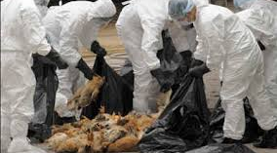
MASS DEPLETION OF FLOCKS IMPOSES RISKS OF INFECTION FOR WORKERS AND ALSO PROBLEMS OF DISPOSAL

Slide 33
VACCINATION AGAINST HPAI
INTRODUCTION OF AN EXOTIC INFECTION
VACCINATION NOT RECOMMENDED.
(PRESENCE OF ANTIBODIES PRECLUDE TRADE)
PRESENCE OF ENDEMIC INFECTION
INACTIVATED EMULSIONS (STABLE, HIGH ANTIGEN TITER)
DIVA APPLIED IN ITALY H7N3 VACCINE AGAINST H7N1
RECOMBINANT rHVT –H5 PRODUCT DEVELOPED (CEVA)
NO LIVE ATTENUATED VACCINES!!!

Slide 34
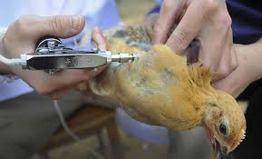
I/M VACCINATION OF CHICKS WITH INACTIVATED EMULSION SUPPRESSES MORTALITY BUT DOES NOT ERADICATE INFECTION. LOW SHED RATE OF VIRUS FOLLOWING VACCINATION.

Slide 35
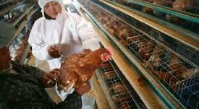
VACCINATION OF INDIVIDUAL HENS IN THE FACE OF INFECTION IS LABORIOUS

Slide 36
TRADE CONSIDERATIONS
TO REGULATE TRADE, THE WTO (WORLD TRADE ORGANIZATION) RECOGNIZES STANDARDS DEVELOPED BY THE OIE (WORLD ORGANIZATION FOR ANIMAL HEALTH).
CANNOT BAN TRADE IF SAME DISEASE OCCURS IN IMPORTING NATION
ALL H5 AND H7 AND HIGH-PATH ISOLATES TO BE REPORTED TO OIE 1 DAY FOLLOWING CONFIRMATION. OTHER AI ISOLATES AT ANNUAL INTERVALS . BILATERAL AGREEMENNTS EXIST BETWEEN NATIONS MANDATING DISCLOSURE OF LPAI
SOME NATIONS (RUSSIA) USE AI AS AN EXCUSE FOR POLITICAL EMBARGOS
MANY NATIONS (INDIA) USE AI TO PROTECT LOCAL PRODUCTION

Slide 37
QUESTIONS TO PONDER
1. CAN I APPLY THE BASICS OF AI VIRUS MOLECULAR
BIOLOGY TO AN UNDERSTANDING OF THE DISEASE?
2. DO I UNDESTAND THE EPIDEMIOLOGY OF AI AND THE
SIGNIFICANCE IN PREVENTION AND CONTROL?
3. AM I AWARE OF THE SOCIOECONOMIC IMPACT OF AI?
4. COULD I DEVELOP A PROGRAM TO ERADICATE EXOTIC AI?
5. COULD I APPLY THE PRINCIPLES ACQUIRED IN THIS REVIEW
TO LIMIT INTRODUCTION AND DISSEMINATION OF AI?

Slide 38
THANK YOU
QUESTIONS?
COMMENTS!

