Slide 1
FINANCIAL BENEFITS FROM HATCHCARE
Simon M. Shane FRCVS,PhD, BVSc,MBL, ACPV.
HatchTech Breakfast Meeting
IPPE Feb. 13th 2019

Slide 2
ADOPTION OF HATCHCARE
Years Installations Chicks/week*
2014-2016 5 4.2 m.
2017-2018 9 10.2 m.
Ordered +20 +20.0 m.
*Range 0.4m to 2.5 m chicks/week.

Slide 3
REVIEW OF TRILLIUM HATCHERY, ONTARIO

Slide 4
VISCOM MODULE ADDING FEED TO BASKETS

Slide 5
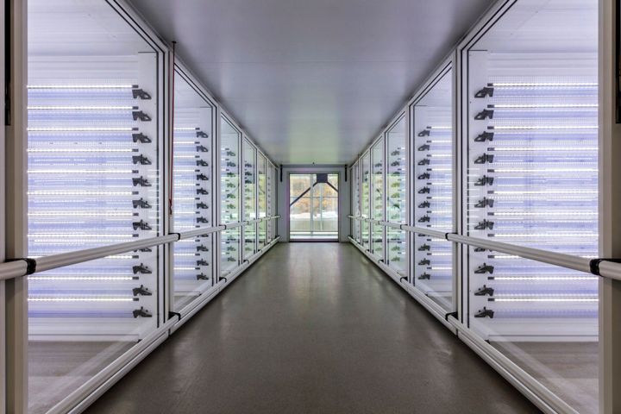
HATCHER BAY
hatchtech setter bay.docx

Slide 6
RACKS AT PULL

Slide 7
CHICK BASKET BEFORE HATCH COMMENCES

Slide 8
CHICKS EMERGE OVER A 24+ HOUR WINDOW

Slide 9
HATCH RESIDUE IN TRAY

Slide 10
CHICKS IN HATCHCARE BASKET. NO RESIDUE

Slide 11
CHICKS DRINK WITHIN MINUTES AFTER DRYING

Slide 12
CHICKS EAT WITHIN MINUTES AFTER DRYING

Slide 13
FINAL INSPECTION

Slide 14
HATCHTRAVELLER TRANSPORT SYSTEM

Slide 15
JUSTIFICATION FOR HATCHCARE
Irrespective of length of hatch window HatchCare:-
Allows individual chicks to drink soon after drying to avoid dehydration.
Allows individual chicks to eat soon after drying to expedite absorption and metabolism of yolk and to promote intestinal development

Slide 16
HATCHCARE LOWERS STRESS ON CHICKS
Constant light intensity at 25 foot candles from LED arrays.
Low noise level in hatcher
CO₂ <1,500 ppm; Humidity <55%
Chicks have no contact with hatch residue.
Adequate space (7.5”per chick) in basket, 40% more than conventional
Chicks are vaccinated, counted and delivered in the same basket

Slide 17
IMPROVED BIOLOGICAL CHICK PARAMETERS
From Hatch to pull:-
Parameter Conventional HatchCare
Chick weight -6.0% +4.0%
Yolk absorption +3.8% + 4.3%
Intestinal mass +0.9% +1.4%

Slide 18
HATCHCARE ADVANTAGE IN EU COMPARISONS
EU Standard vs. HatchCare: 2.5 million broilers
Hatchability: +5.3% to 87%
Chick mass: +12% to 52g
7-day mass; +9.5% to 190g.
42-day livability; +1.6 to 95.6%
42-day mass: +4.9% to 5.08 lb.
FCR: -2% to 1.51
EPF: +7.9 to 352 Valued at 26 U.S. cents per bird

Slide 19
IMPROVEMENT FROM HATCHCARE: CANADA*
Comparison 2015 to 2016
Hatchability 85% to 90%
7-day weight 170g to 190g
7-day mortality: 2.1% to 1.3%
2015: 5.01 lb. 40 days, 1.68 FCR
2016: 5.57 lb. 41 days, 1.66 FCR
*Synergy Hatchery Nova Scotia,

Slide 20
U.S. SIMULATION USING HATCHCARE: VALUES
Current Improvement HatchTech
6.51 lbs. +5% 6.83 lbs.
1.82 FCR -3% 1.77 FCR

Slide 21
U.S. SIMULATION USING HATCHCARE; $ BENEFITS
Reduced feed cost: 0.6c/Lb.live
Reduced chick cost: 0.3c/Lb. live
Reduced live cost: 0.9c/Lb. live
At 1 million/week reduced cost = $61,200
For calculation of Net Benefit assume $50,000/week or $2,600,000 /annum

Slide 22
PROJECTION OF PRESENT VALUE OF BENEFITS
YEAR 1, 2, -------10.
Discount Factor @ 5%: 0.95, 0.91 ---- 0.61
Annual benefit, $million: $2.47, $2.37---$1.59
Assuming a conservative $50,000/week saving in cost, the Present Value of annual benefits from HatchCare represents $10.9 million over 10 years with a 5% discount factor

Slide 23
BENEFIT RATIO FOR INVESTMENT IN HATCHCARE
Assume incremental capital cost for HatchCare over conventional incubation amounts to $1,4 million for a capacity of 1 million chicks per week.
Net present value of benefits is $10.9 million
Ratio of discounted benefits to incremental capital cost is:-
$10.9million/$1.4 million = 7.8

Slide 24
THANK YOU
QUESTIONS
COMMENTS

