Slide 1


Meeting Broiler Market Needs with
Silvafeed® Nutri P Plant Bioactives
E. Ernest M. Pierson, Ph.D.
epierson@Silvateam.com
ANIMAL NUTRITION

Slide 2
2
Agenda:
We live in a dynamic market!
Poultry market needs Silvafeed®Nutri P
Profit considerations: π = f(Revenue – Cost) +/- Risk ($, life/death)
Plant bioactives in Silvafeed® Nutri P:
    Broiler and layer feeding studies
    Process variation - A consistent system is a more profitable system
    Food Safety
    Environment and sustainability
    Animal well being and worker safety
    Differentiation
Summary and Conclusions

Slide 3
Poultry market needs:
Market
Needs
Cost
Variation
Food
Safety
Environ-ment &
Sustainability
Animal Well Being & Worker Safety
Differen-tiation

Slide 4
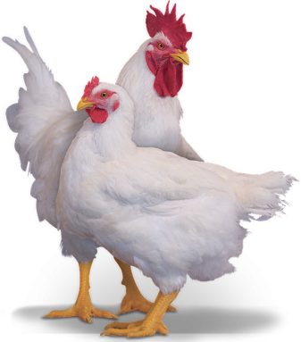
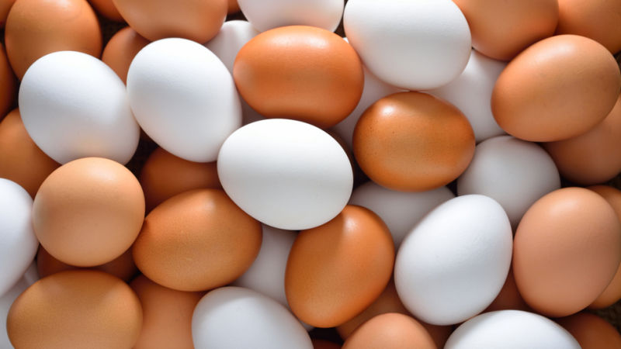
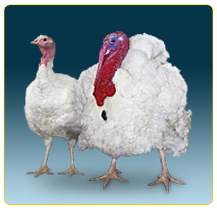

Considerations in poultry market profitability:
4
Silvafeed® Nutri P: A tool producers can use to impact revenue, reduce cost, and diminish risk.
$$\boxed{Profit=Revenue −Cost}$$
But what about, risk in poultry production?

Slide 5
A few words about: Risk…
5
What are some risks that you see in your business?
TYPE OF RISK | “’GOOD” RISK | “BAD” RISK
MARKET: Demand & Disease | Increased demand for egg and broiler meat | Outbreak of AI, birds die, lose market
COMPANY: New product introduction Elon Musk-Tesla | Successful: Continue in the game | Unsuccessful: out of game
COMPANY: E. coli contamination | Strengthen brand with biosecurity/food safety programs | Goes out of business: Hudson Foods 1997
BRAND: Salmonella contamination | Strengthen brand with biosecurity/food safety programs | Lose market share, increase cost, brand damaged: Foster Farms 2013 BRF 2019?
SOCIETY: Antibiotic resistance | Opportunity for alternatives | Antibiotics ineffective in human medicine
Silvafeed® Nutri P: A tool producers can use to impact revenue, reduce cost, and diminish risk.

Slide 6
6
Silvafeed® Nutri P:
Contains bioactive compounds extracted from the wood of the Italian Chestnut and Argentine Quebracho trees
Bioactive secondary plant compounds known and used by man for centuries.
Natural functions:
  Since plants can’t move and have no “immune system”, tannins evolved to meet the challenges of:
    Molds/mycotoxins,
    Physical injury (insects, being eaten by animals, loss of branches),
    Bacterial/viral insult, and,
    Parasites.

Slide 7
7
Silvafeed® Nutri P – How does it work in poultry?
THE BIOACTIVE COMPOUNDS IT CONTAINS…
Affect the gut microbiome (living organisms in the gastrointestinal tract):
  Bacteriocidal & bacteriostatic
  Increase beneficial bacteria (more Firmicutes:less Bacteroidetes)
Modulate gut movement (peristalsis)
Neutralize bacterial toxins (C. perfringens)
Reduce oxidation (antioxidant)
Improve gut health (immunomodulatory & anti-inflammatory)
Do not result in bacterial resistance

Slide 8
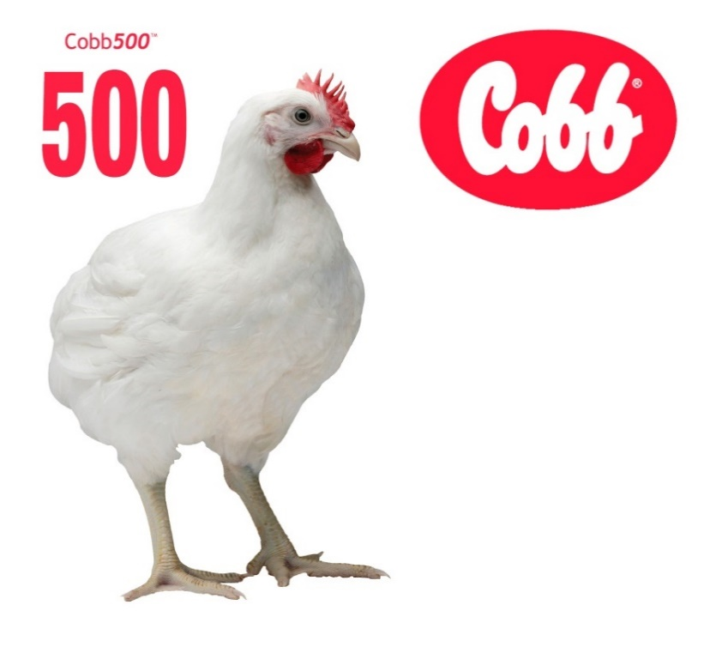
8
Market needs
Silvafeed®Nutri P Plant Bioactives
Broiler Research

Slide 9
9
Silvafeed® Nutri P and Broiler Live Performance:
Broiler Field Trial in Argentina
  Cobb® 500 Broilers fed antibiotic free (ABF) diets containing 1 kg Silvafeed® Nutri P (T1-NP)/MT, or, broilers fed the same diet containing commercial antibiotic growth promotants (T2-AGP) in a one-year paired house field comparison
  A total of 720,000 broilers placed and grown to 35 (360,000 placed), or, 42 (360,000 placed) day of age, respectively.
  Side x side paired house comparison: 6 houses (3 ABF-NP) ; 3 AGP)
  Broilers fed ABF diet with NP had improved performance: body weight, feed conversion, livability.
  Redondo, E., et al. (2018). Poultry Sci. 97 (E-suppl. 1): 318 (Abstr.)

Slide 10
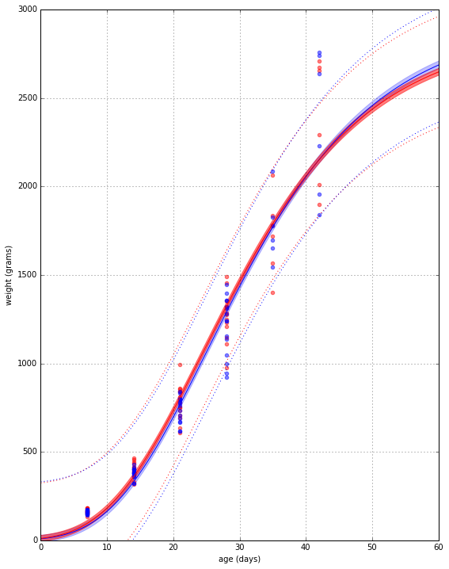
Results: Significant difference in weight (ABF > AGP) - Gompertz model
Silvafeed® Nutri P - ABF
AGP
P = 0.0023
Live weight (Grs)
Growth curve: W(t) = Aexp(−exp(−k_{G}(t − T_{i})))
Age, Days

Slide 11
Live performance results at 35 or 49 Days of Age
 | 35 Days of Age, Treatment: |  |  | 49 Days of Age, Treatment:
 | T1 NP-ABF | T2-AGP | Prior Year Average | T1 NP-ABF | T2-AGP | Prior Year Average
*Mean live weight, kg ± SEM | 1.491 ± 0.019 | 1.452±0.064 |  | 2.608 ± 0.015 | 2.538 ± 0.068
**CV, % | 1.3 | 4.4 |  | 0.6 | 2.7
FCR, Fd:Wt | 1.635 | 1.624 |  | 1.955 | 1.983
Livability, % | 99.1 | 99.2 | 98.7 | 97.5 | 97.6 | 94.4
*Mean live weight at processing plant
**CV from live weight variation at processing plant

Slide 12
12
One-year Argentine field trial: Better live weight uniformity in broilers fed Nutri P (ABF) diets Vs diets with AGP.
 | 5 weeks |  | 7 weeks
 | T1-NP: ABF | T2-AGP | T1-NP: ABF | AGP
*Mean live weight, kg ± SEM | 1.491 ± 0,019 | 1,452 ± 0,064 | 2,608 ± 0,015 | 2,538 ± 0,068
**CV, % ***CV, % | 1.3 2.2 | 4.4 7.7 | 0.6 0.8 | 2.7 3.8
Less process variation (noise; lower CVs) in broiler live weight
with ABF (Nutri P) Vs AGP over a one (1) year period
*Mean live weight at processing plant
**CV from live weight variation at processing plant
***CV from 30 or 60 birds sampled from each house at the end of the experiment

Slide 13
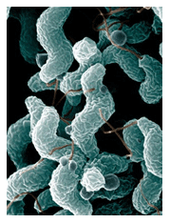
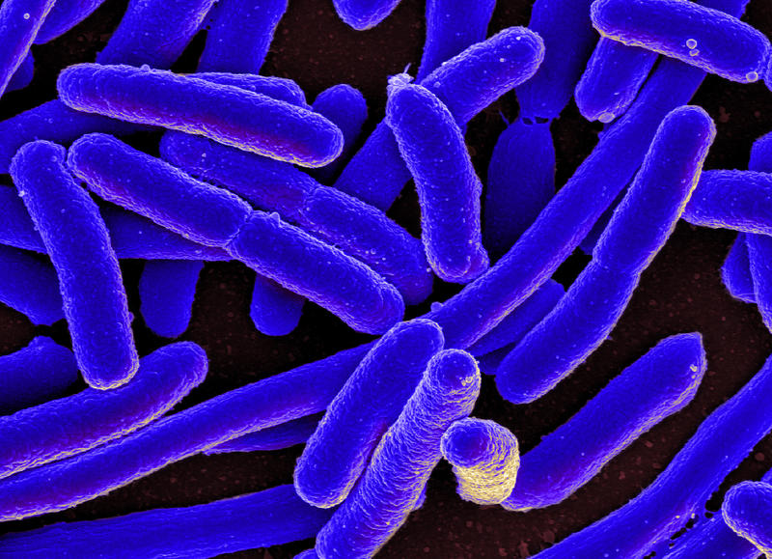

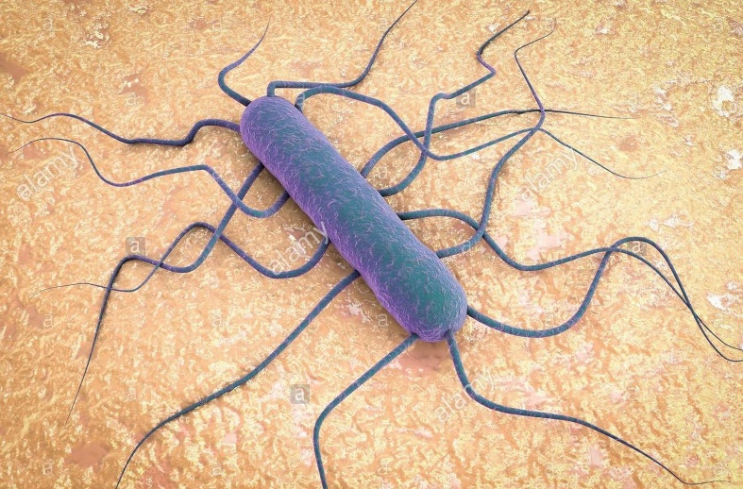
13
Market needs – Food Safety
The journey of the understanding of the effect that tannins have
on bacteria of importance to human and animal health is ongoing.
Campylobacter
E. coli
Salmonella
Listeria
Redondo, L. et al., 2019. Tannins to control Salmonella in poultry. 2019 Abstracts International Poultry Scientific Forum February 11-12. P. 10.
The combination of chestnut and quebracho tannin extracts were effective in reducing the impact of strains important to human (S. enteritidis) and poultry (S. gallinarum; fowl typhoid) health, respectively, as measured by cell damage and efficacy against challenge.
Silvateam doing research to develop the optimum product(s) to meet this need.

Slide 14
14
Market needs – The Environment
Litter quality: Brazil field trial visual assessment
Litter nitrogen: Schiavone et al., 2007; Chestnut tannin

Slide 15
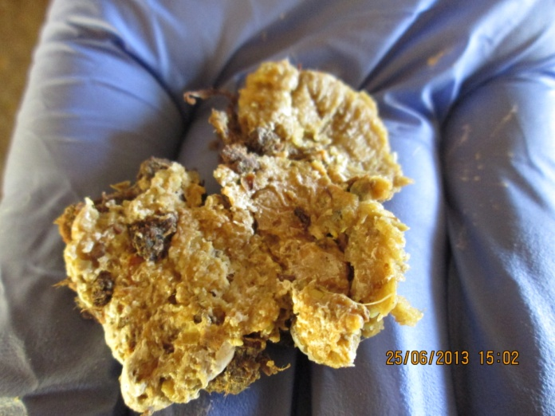
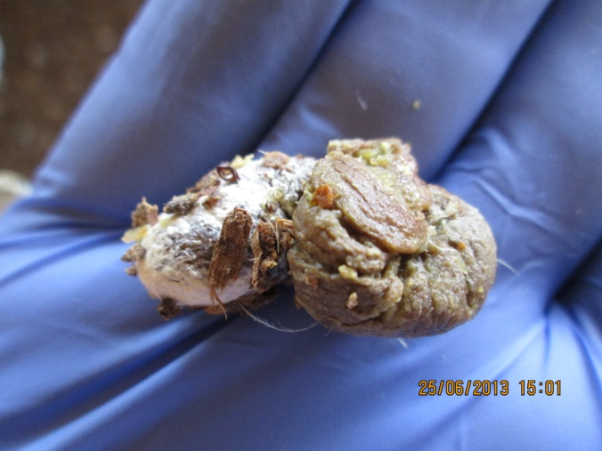
Litter quality: The Visual Test (Brazil Experience) Firmer Droppings
15
Typical feces from control broilers
Typical feces from Nutri P fed broilers
Commercial 10,000 bird house in collaboration with an integrated broiler producer in Southern Brasil.
Diet formulated to typical commercial specification.
Normal broiler house management practices were followed.
At placement, six (6) areas inside of the house were separated with fencing, each contained 100 birds.
Birds were given the field diet in use at the time of the trial containing 1 kg of Silvafeed® Nutri P/MT diet added “over the top”.
At 28 days of age, fecal samples were collected from the pens with broilers fed Nutri P and compared to similar samples collected from the bird in the other areas of the house.

Slide 16
Litter quality: Litter Nitrogen (Schiavone et al., 2007) Linear (P < 0.05) effect ENC 0 vs Mean of ENC 15,20,25; Quadratic (P < 0.01 & < 0.05) Effect of ENC level
16
*
*
Silvafeed® ENC Plant Bioactive from Italian Chestnut
*Significantly different than control P<0.05

Slide 17
17
Market needs – Animal Well Being and Worker Welfare
Better litter quality means a better environment for the bird and the animal care giver.
Drier litter
  Fewer flies
  Less ammonia: to affect the bird and the animal care giver
Improved animal well being
  Few crippled/injured birds
  Better gut health – fewer intestinal lesions
  More favorable microbiome
Better paw quality: fewer condemns, more revenue

Slide 18
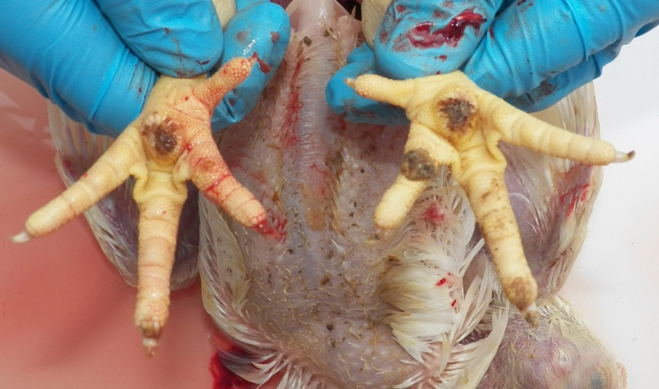
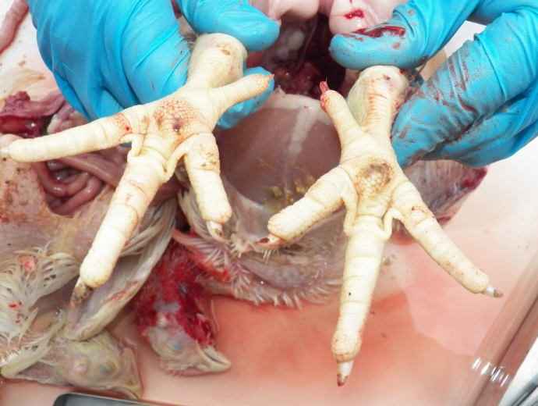
18
.
Field evaluation of paw quality was better in Silvafeed®Nutri P fed birds compared to control birds (Brasil field trial 2014)
Paws from representative
control bird
Paws from representative
Nutri P bird
Improved animal well being
Increased paw yield - revenue

Slide 19
Increased Yield of Paws – Reduced Plant Foot Pad Condemns
Southern Brasil Broiler Integrator: January 2015 - March 2016
Diets without 0.1% Nutri P
2 paws ~ 2% carcass weight = ~ 21 metric ton (MT)
more paws /month @ US$ 850/MT
= ~ US$ 17,850 increased revenue/month with Nutri P

Slide 20
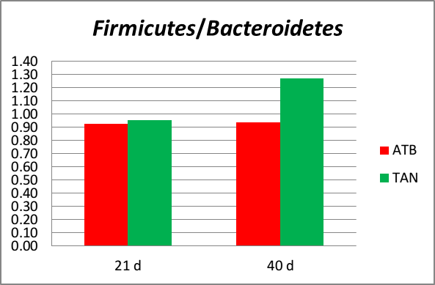
20
A more favorable gut microbiome was
observed in Broilers fed Silvafeed® Nutri P (Redondo et al., 2018)
The Firmicutes/Bacteroidetes ratio in broilers fed diets
with antibiotics (ATB), or, with Silvafeed® Nutri P (TAN) at 21 and 40 days of age

Slide 21
Market needs – Differentiation (Hughes, 2018)
Attributes associated with chicken are important for differentiation of product to the consumer
Adding “adjectives” before the noun increases its value
  Antibiotic free with Nutri P
  All natural with Nutri P
  Organic with Nutri P (in Europe; OMRI certification ongoing in US)
  All vegetable diets with Nutri P
  Sustainably raised with Nutri P
  Farm to fork with Nutri P
  Increased omega 3 fatty acids with Nutri P
  Better your paws with Nutri P
The “green” bar is being raised. Producer may not get more for their product with these features but could get less if they don’t have “adjectives”.

Slide 22
What are the “sweet spots”?
Revenue (+$); Cost (-$); Risk, Responsibility
Environ-ment
Animal well being and worker safety
Differentia-tion
Cost
Process Variation
Food Safety
Nutri P
Nutri P
Nutri P
Nutri P
Nutri P
Silvafeed® Nutri P: A tool producers can use to impact revenue, reduce cost, improve uniformity, enhance sustainability, improve welfare and diminish risk.

