Slide 1
Bottom-line Financial Outcome May Not Be a Sensitive Test for Detecting Effective Management Inputs
James T. Barton DVM, ACPV, ACAW
Pacific Vet Group, USA, Fayetteville, Arkansas

Slide 2
Poultry Companies Consume Information
High Quality
Repeatable
Standardized

Slide 3
What kind of information?
Rate of lay
Fertility
Hatchability
Mortality
Cocci Lesion Scores
Live Weight
Feed/Calorie Conversion
Condemnation

Slide 4
Veterinary Judgement?

Slide 5
How can information be inaccurate?
Rate of lay – Head Count
Fertility – Observation Error, Sample Size
Hatchability – Counting Errors, Culling
Mortality – Counting Errors
Posting Sessions – Observation Error, Sample Size, Bias
Live Weight – Shrink, Trailer Tare, Head Count, Cumulative Error
Feed/Calorie Conversion – Cumulative Error, Wastage, Calorie Estimation
Condemnation – Observation Error, Weighing Error, Bias

Slide 6
Small effects shadowed by variation

Slide 7
Small effects shadowed by variation
Able to prevent using ineffective product

Slide 8
Small effects shadowed by variation
Not able to identify an effective product

Slide 9
Measurements
It is difficult to make precise measurements when the baseline is moving.
http://www.metoffice.gov.uk/public/weather/marine/

Slide 10
Feed Conversion
One point of FCR – “We see that type of variation every week. It’s probably not due to the treatment.”

Slide 11
Feed Conversion
Four points of FCR – “That’s an unreasonable improvement. It’s probably not due to the treatment.”

Slide 12
Feed Conversion
“Take credit for the successes. You’ll get blamed for the failures.”
Better employee management
New focus on litter management
Improved grower relations
Feed change you recommended
LED lights
Chlorination program

Slide 13
Iconoclastic farming is increasing
Antibiotic Free
Free Range
Enriched
Organic

Slide 14
This Change Causes Instability
Can not compare to other/previous flocks
Feed more expensive
Non-GMO
Organic
Veg Fed
Locally sourced?
Diseases can’t be controlled without antibiotics
Necrotic enteritis
Omphalitis
Vertically transmitted Mycoplasmosis
http://www.designboom.com/design/learn-to-unlearn-objects-revised-by-lina-marie-koeppen/

Slide 15
how can the veterinarian assess?
Controlled tests
Validated results
Veterinary Judgement

Slide 16
Useful & accepted tests
Antibiotic sensitivity
Pen trials
Serology

Slide 17
Veterinary judgement
Fecal bacterial analysis
Salmonella testing

Slide 18
Suspect Procedures
Artificial Fecal Inoculum
Reporting % Salmonella reduction (instead of log)
Short chain fatty acid analysis
Microflora shift

Slide 19
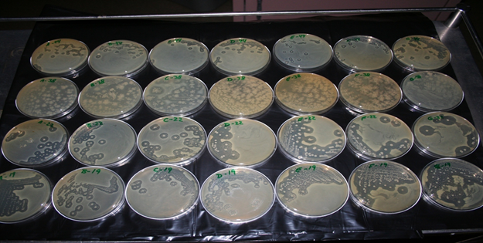
Suspect Procedures
Microflora Shift ≠ Performance Improvement
Don’t Rely On In Vitro Testing Without In Vivo Validation!

Slide 20
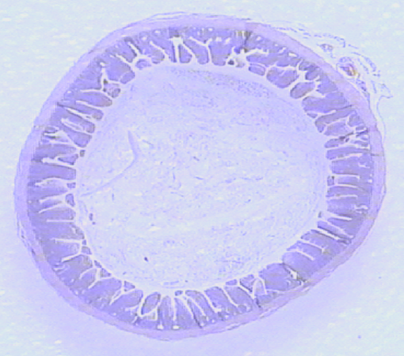
Uncertainty doctrine
Make a decision when you have 60% certainty
Microbiological Evidence
Physiologic science
Pen trials
Professional judgement

Slide 21
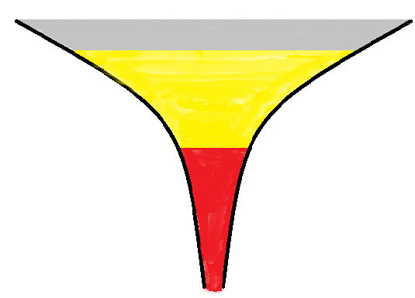
INCIDENT PIT

Slide 22
Farm Bankruptcy Incident Pit
Biosecurity Breach
Excess Mortality
Back Injury
Reduced Income
Delinquent Mortgage
Utilities cut off
Reduced Productivity

Slide 23
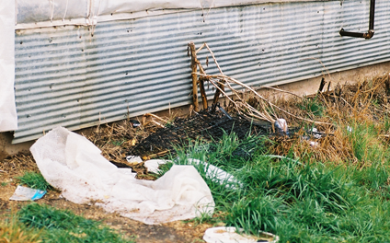
Hidden Costs

Slide 24
Cost of Obtaining new farms
Financial Evaluation & Legal
Environmental Assessment / Regulatory
Training & Indoctrination
Feed Delivery & Live Haul Learning Curve
Unanticipated Grower Costs
Neighbor Complaints & Interference

Slide 25
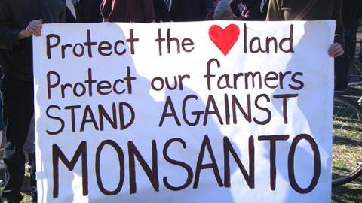
Loss of social license to farm

Slide 26
Cost of loss of status
Missed orders
Reduced price for product
Time (with lower price) to regain status
Cost to reacquire customer

Slide 27
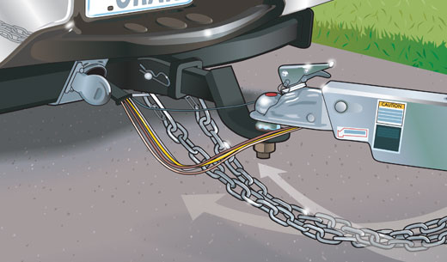
Least Cost = Bare Minimum
No margin for error
Single problem means out of compliance
http://www.boattraileroutlet.com/information-resource/trailer-tips

Slide 28
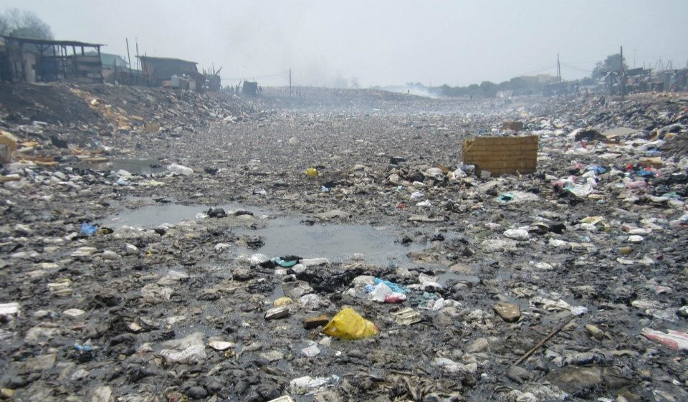
If you’re going through hell, keep going. Winston Churchill http://www.brainyquote.com/quotes/authors/w/winston_churchill.html

Slide 29
Thank you
Questions?

